Slide 1


Yoi Chang Calderon
10-08-2023

Slide 2

Outline
Executive Summary
Introduction
Methodology
Results
Conclusion
Appendix

Slide 3
Executive Summary
• In this work Data Science Methodologies were used in order to implement Machine Learning Algorithms to the SpaceX Falcon-9 rocket data set with the purpose of predicting if the first stage of this rocket will land successfully.
• The Machine Learning models implemented achieved a mean accuracy of 0.84 over all the data set, whereas the mean Machine Learning models scores on test data obtained was 0.944.

Slide 4
Introduction
• The commercial space age is here, companies are making space travel affordable for everyone.
• Perhaps the most successful is SpaceX due this company can make rocket launches at relatively inexpensive prices.
• SpaceX advertises Falcon 9 rocket launches on its website with a cost of 62 million dollars; while other providers cost upwards of 165 million dollars each.
• Much of the savings is because SpaceX can reuse the first stage of its Falcon 9 rocket.
• Therefore, if we can determine if the first stage will land, we can determine the cost of a launch

Slide 5

Section 1

Slide 6
Methodology
Executive Summary
Data collection methodology:
Describe how data was collected
Perform data wrangling
Describe how data was processed
Perform exploratory data analysis (EDA) using visualization and SQL
Perform interactive visual analytics using Folium and Plotly Dash
Perform predictive analysis using classification models
How to build, tune, evaluate classification models

Slide 7
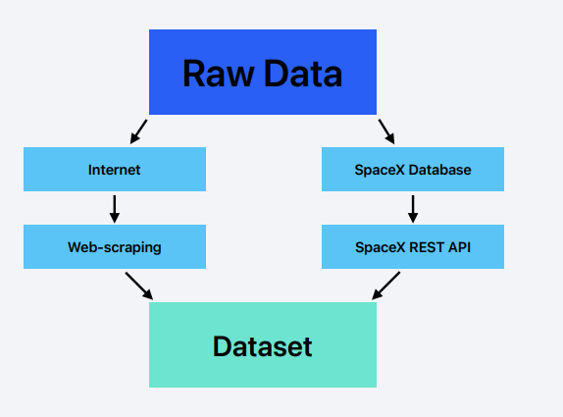
Data Collection
• The raw data needed for the project is available either on the web or in the SpaceX databases.
• So basically there are two ways of getting the data for this project:
1. By making web-scraping in the related Wiki pages
2. Using the SpaceX REST API

Slide 8
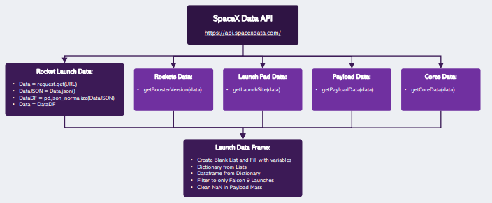
Data Collection – SpaceX API
To use the SpaceX API effectively first we need to find the API endpoints or URL and then we can use the request libraries to obtain the launch data. This result can be viewed by calling the .json() method. Our response will be in the form of a JSON, specifically a list of JSON objects. To convert this JSON to a dataframe, we can use the json_normalize function.
GitHub Link for the Jupyter Notebook: Lab 1: Collecting the data

Slide 9
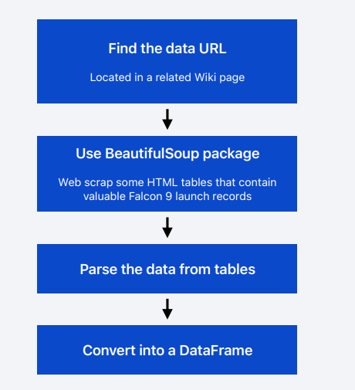
Data Collection - Scraping
• Another popular data source for obtaining Falcon 9 Launch data is web scraping related Wiki pages. We will be using the Python BeautifulSoup package to web scrape some HTML tables that contain valuable Falcon 9 launch records. Then we’ll need to parse the data from those tables and convert them into a Pandas data frame for further visualization and analysis.
GitHub Link for the Jupyter Notebook: Lab 1: Collecting the data

Slide 10
Data Wrangling
Exploratory Data Analysis (EDA) to find some patterns in the data and determine what would be the label for training supervised models.
In the data set, there are several different cases where the booster did not land successfully. Sometimes a landing was attempted but failed due to an accident; for example, True Ocean means the mission outcome was successfully landed to a specific region of the ocean while False Ocean means the mission outcome was unsuccessfully landed to a specific region of the ocean. True RTLS means the mission outcome was successfully landed to a ground pad False RTLS means the mission outcome was unsuccessfully landed to a ground pad.True ASDS means the mission outcome was successfully landed on a drone ship False ASDS means the mission outcome was unsuccessfully landed on a drone ship.
In this lab we will mainly convert those outcomes into Training Labels with 1 means the booster successfully landed 0 means it was unsuccessful.
GitHub Link: Lab 2: Data wrangling

Slide 11
EDA with Data Visualization
The following charts were plotted (see Section 2) in order to have an overview of the relation between the features used and the success rate of the different launches:
• Relationship between Flight Number and Launch Site
• Relationship between Payload and Launch Site
• Relationship between success rate of each orbit type
• Relationship between Flight Number and Orbit type
• Relationship between Payload and Orbit type
• Launch success yearly tren
GitHub Link: Notebook for Peer Assignment

Slide 12
EDA with SQL
• Some SQL queries were performed in order to understand the SpaceX dataset:
Display the names of unique launch sites in the space mission
Display 5 records where launch sites begin with the string ‘CCA’
Display the total payload mass carried by the boosters launched by NASA (CRS)
Display the average payload mass carried by the booster version F9 v1.1
List the data when the first successful landing outcome in ground pad was achieved
List the names of the boosters which have success in drone ship and have payload mass greater than 4000 but less than 6000
List total number of successful and failure mission outcomes
List the names of the booster versions which have carried the maximum payload mass.
Rank the count of successful landing outcomes between 2010 an 2017
GitHub Link: SQL Notebook

Slide 13
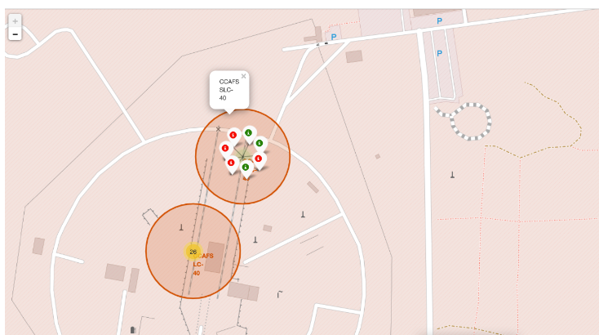
Build an Interactive Map with Folium
• The launch success rate may depend on many factors such as payload mass, orbit type, and so on. It may also depend on the location and proximities of a launch site, i.e., the initial position of rocket trajectories. Finding an optimal location for building a launch site certainly involves many factors and hopefully we could discover some of the factors by analyzing the existing launch site locations.
• The tasks made for building the interactive map in order to find some geographical patterns about launch sites were:
• Mark all launch sites on the map
• Mark the success/failed launches for each site on the map
• Calculate the distances between a launch site to its proximities.
GitHub Link: Locations Analysis with Folium

Slide 14
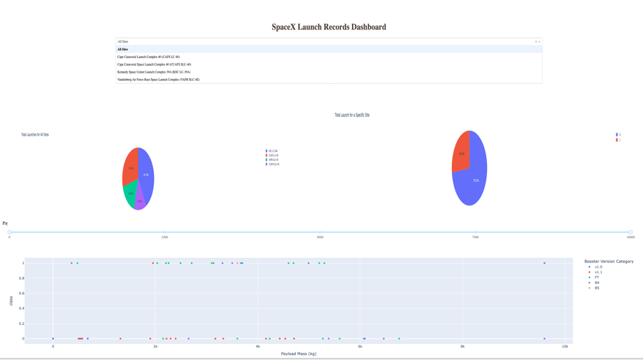
Build a Dashboard with Plotly Dash
The following visuals that were used in the dashboard were intended to give some insights of the site with largest successful launches and highest launch success rate as well for the different F9 boosters and the payloads ranges with highest and lowest success rate:
Launch site drop-down input component
Total success launches by site pie chart
Range slider to select payload
Scatter plot of Payload Mass (kg) vs Success rate per booster version

Slide 15
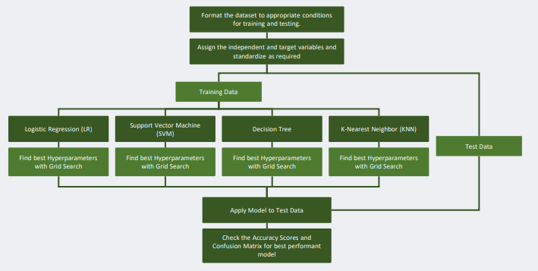
Predictive Analysis (Classification)
• Build a machine learning pipeline to predict if the first stage of the Falcon 9 lands successfully.
• This will include:
Preprocessing, allowing us to standardize our data, and Train_test_split, allowing us to split our data into training and testing data.
Train the model and perform Grid Search, allowing us to find the hyperparameters that allow a given algorithm to perform best.
Using the best hyperparameter values, we will determine the model with the best accuracy using the training data.
Test Logistic Regression, Support Vector machines, Decision Tree Classifier, and K-nearest neighbors.
Finally, output the confusion matrix to evaluate the model efficiency.
GitHub Link: Landing Prediction

Slide 16
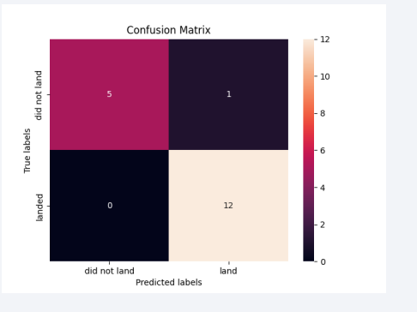
Results
• The accuracy of each model applied to the data obtained was:
• Logistic Regression: 0.82
• SVM: 0.82
• Decision Tree: 0.88
• KNN: 0.84
• While the R2 scored of all ML models applied was 0.94
GitHub Link: Landing Prediction

Slide 17

Section 2

Slide 18
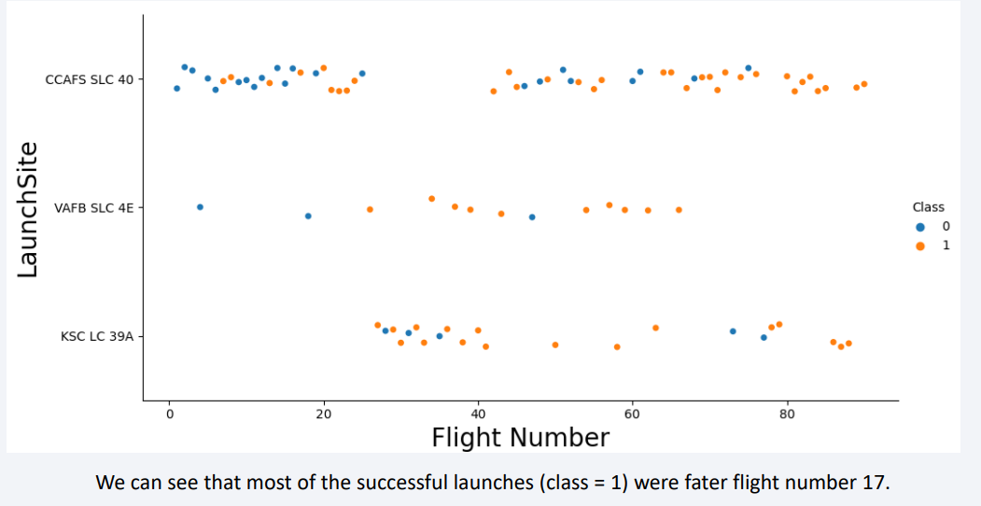
Flight Number vs. Launch Site

Slide 19
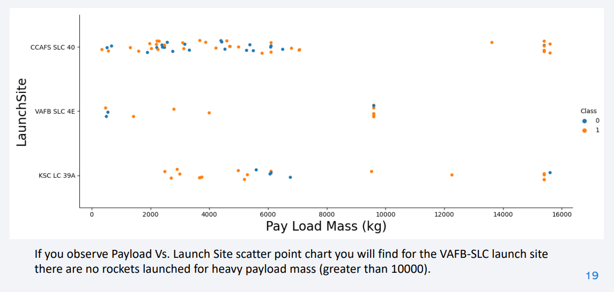
Payload vs. Launch Site

Slide 20
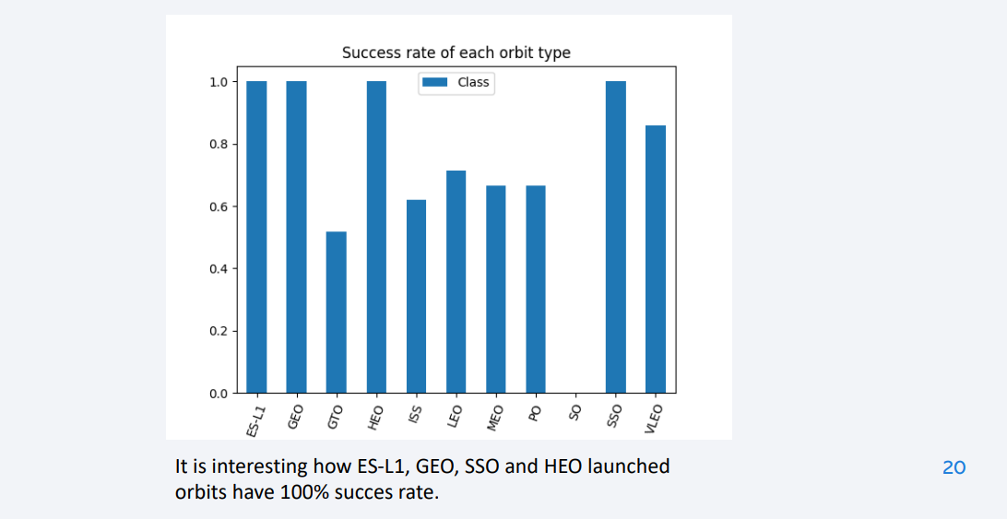
Success Rate vs. Orbit Type

Slide 21
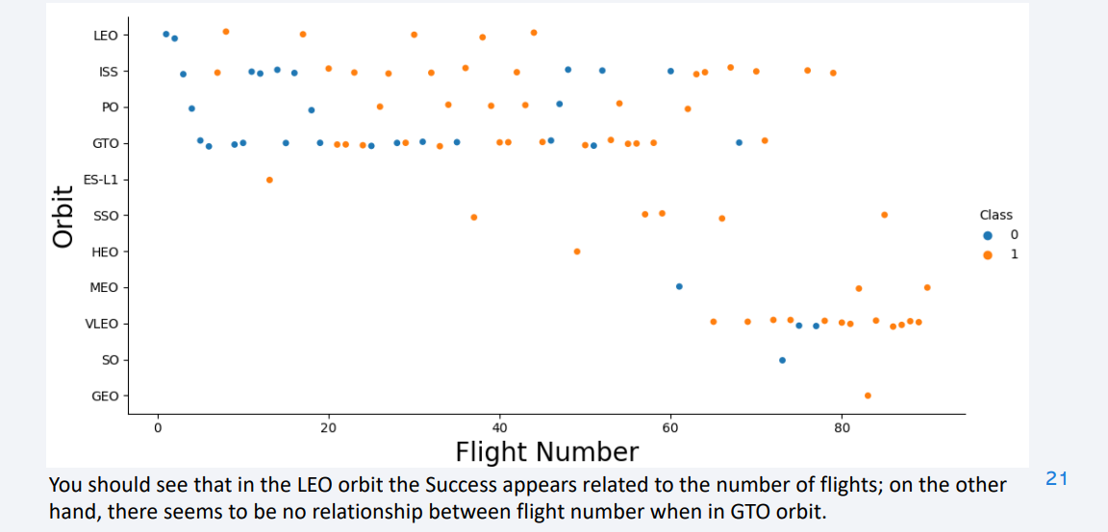
Flight Number vs. Orbit Type

Slide 22
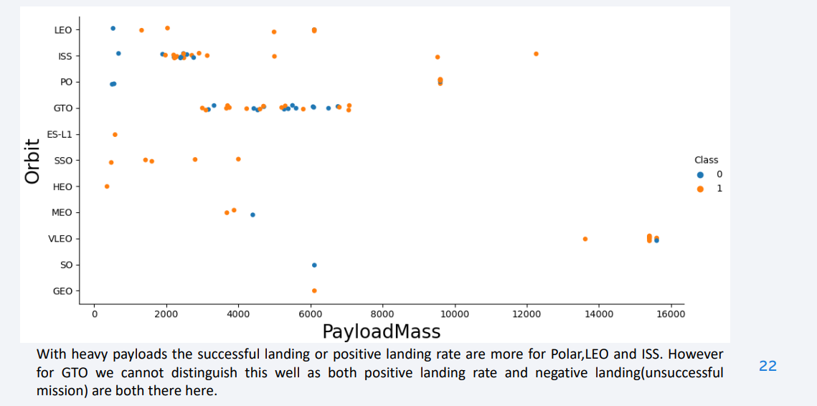
Payload vs. Orbit Type

Slide 23
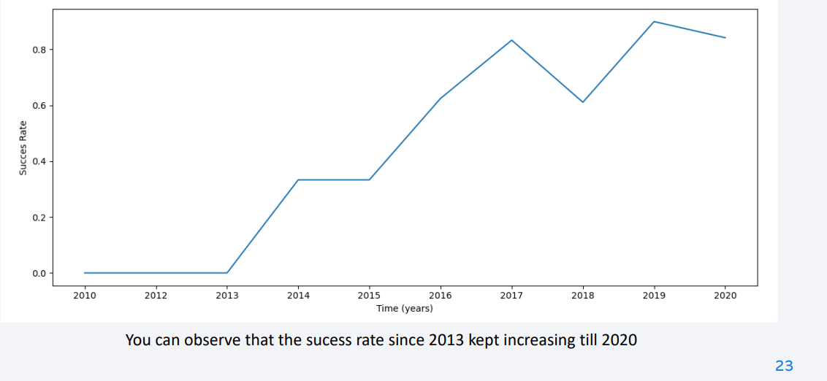
Launch Success Yearly Trend

Slide 24
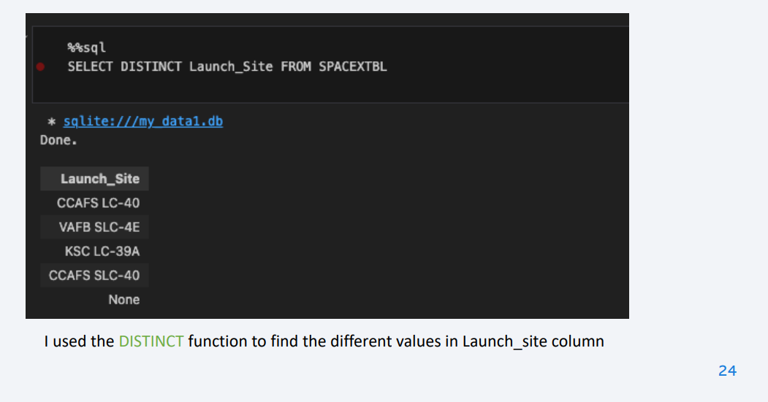
All Launch Site Names

Slide 25
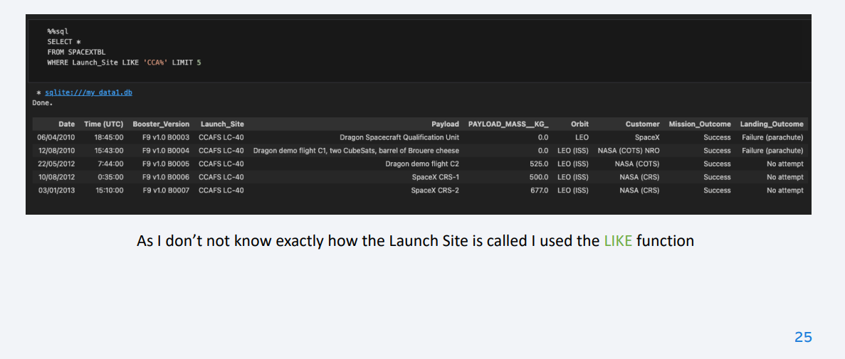
Launch Site Names Begin with 'CCA'

Slide 26
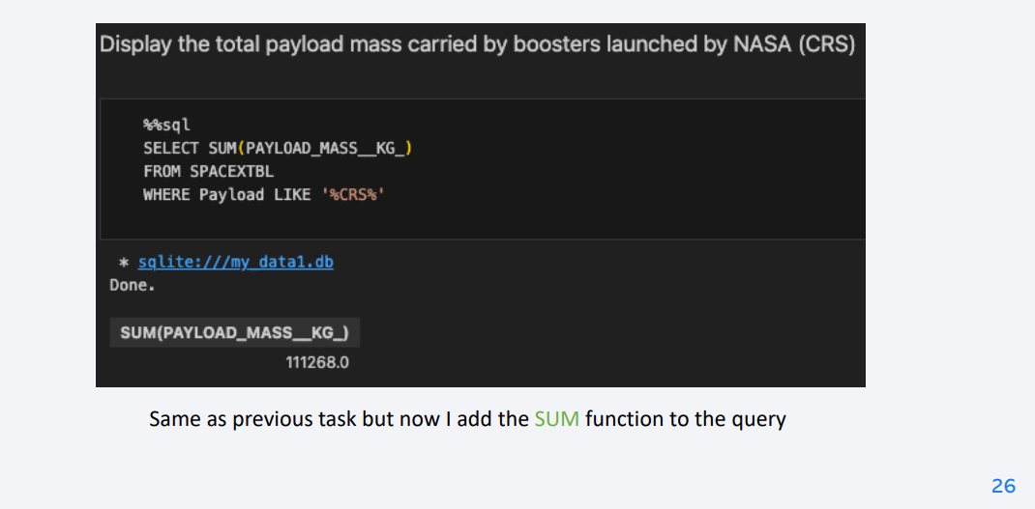
Total Payload Mass

Slide 27
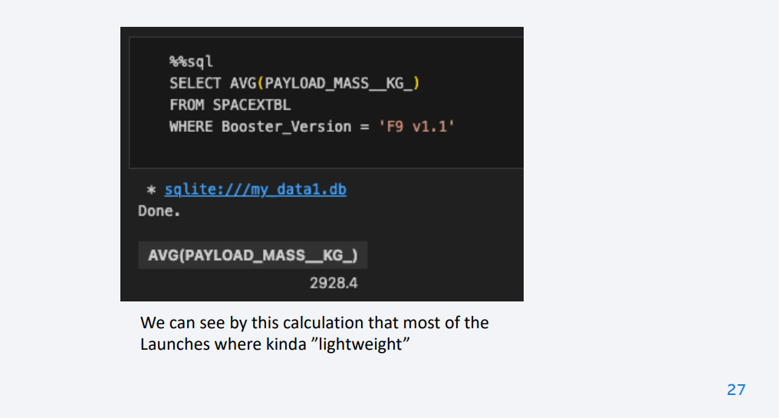
Average Payload Mass by F9 v1.1

Slide 28
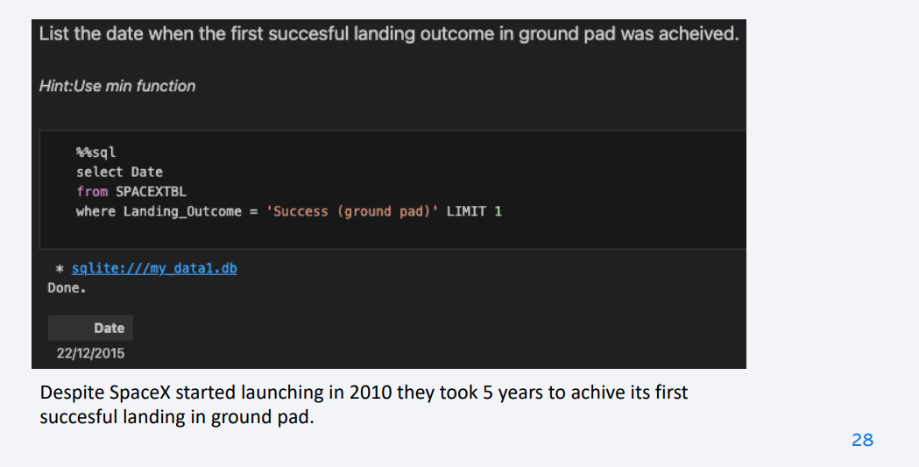
First Successful Ground Landing Date

Slide 29
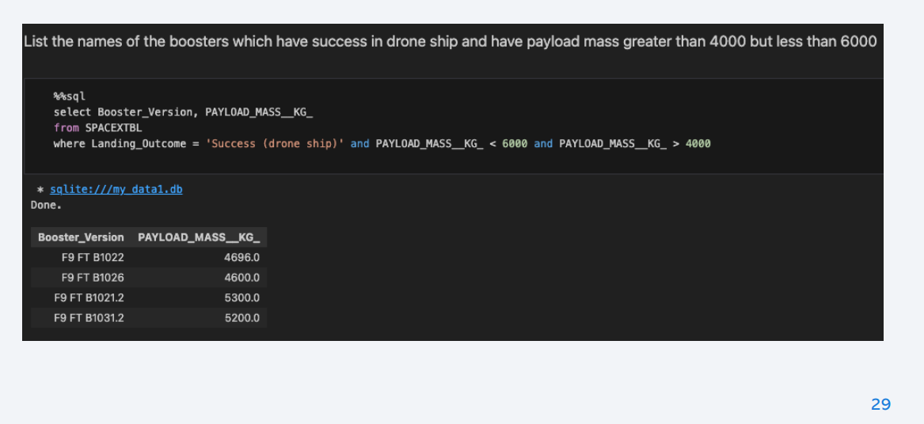
Successful Drone Ship Landing with Payload between 4000 and 6000

Slide 30
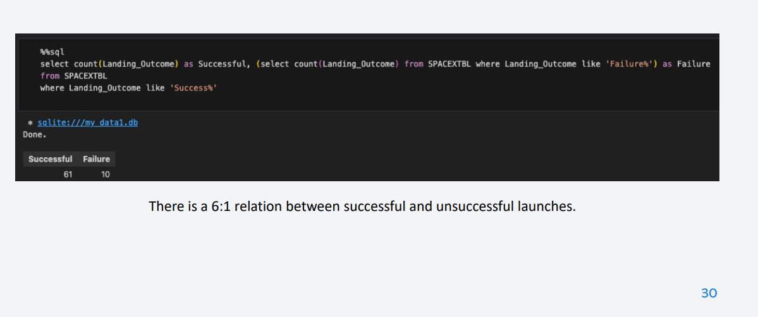
Total Number of Successful and Failure Mission Outcomes

Slide 31
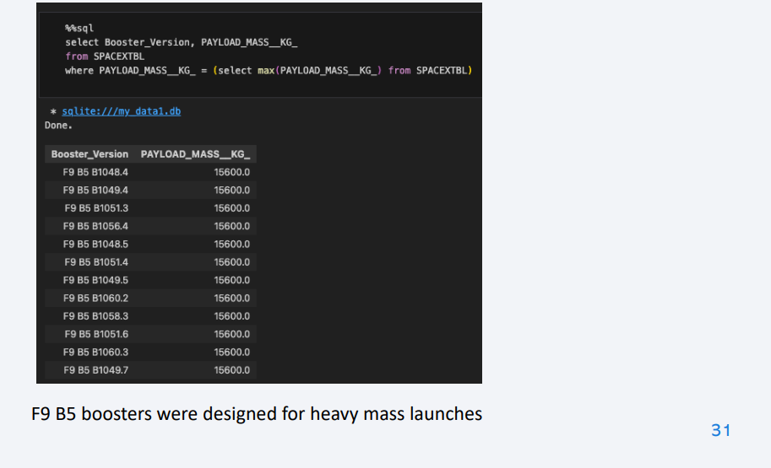
Boosters Carried Maximum Payload

Slide 32
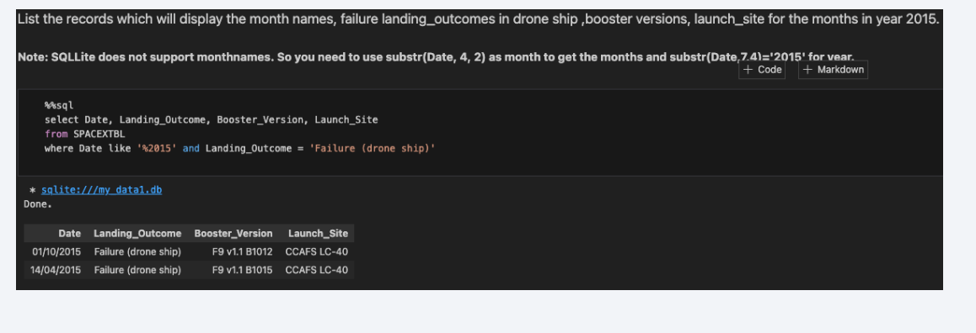
2015 Launch Records

Slide 33
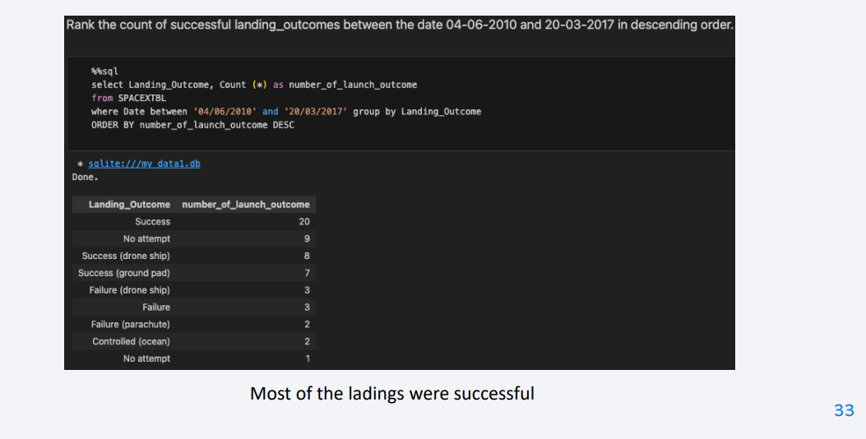
Rank Landing Outcomes Between 2010-06-04 and 2017-03-20

Slide 34

Section 3

Slide 35
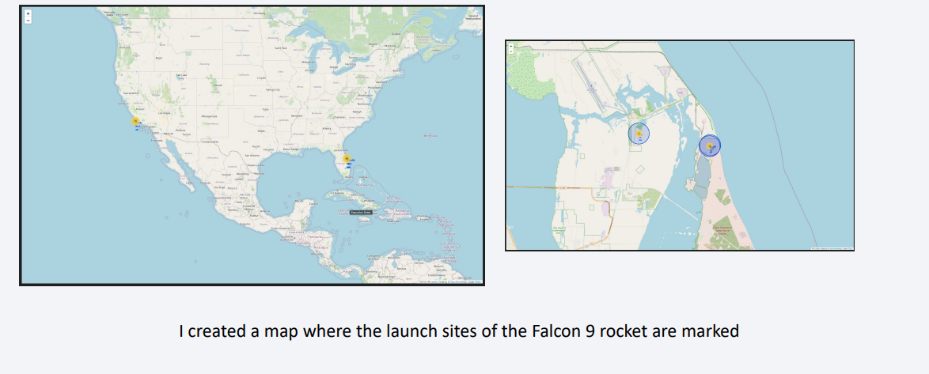
Folium Map Screenshot 1

Slide 36
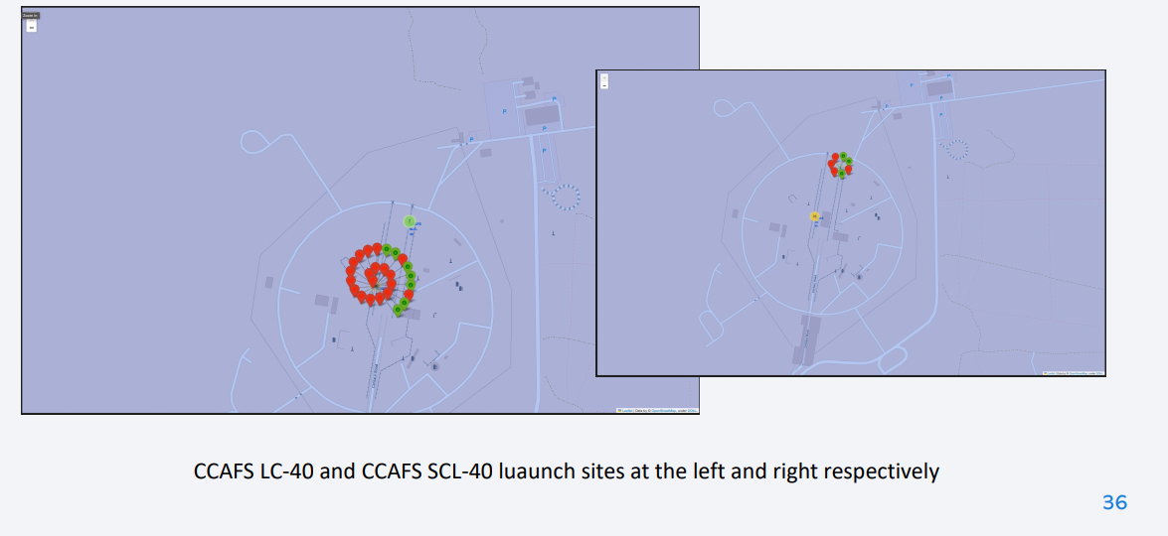
Markers of successful and failed launches at each site

Slide 37
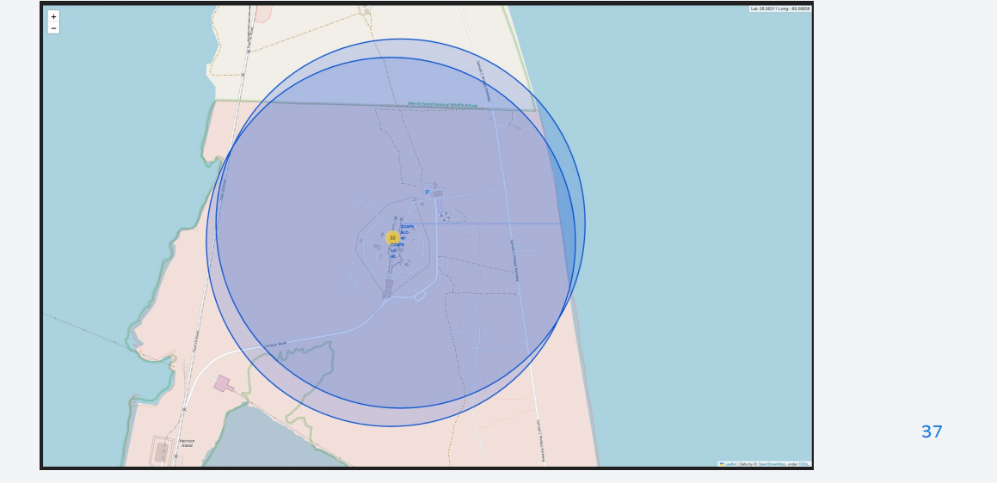
Distance between a launch site to its proximites

Slide 38

Section 4

Slide 39
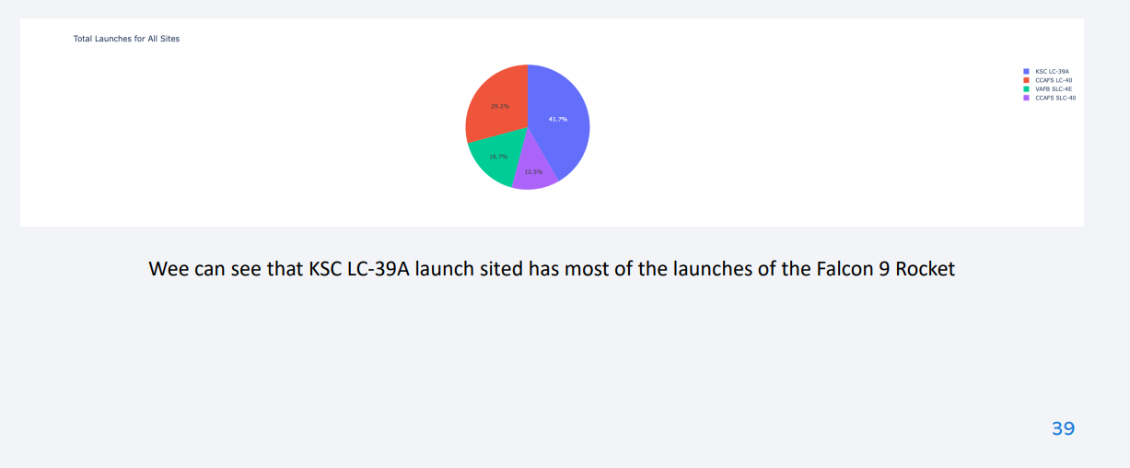
Total Launches for All Sites

Slide 40
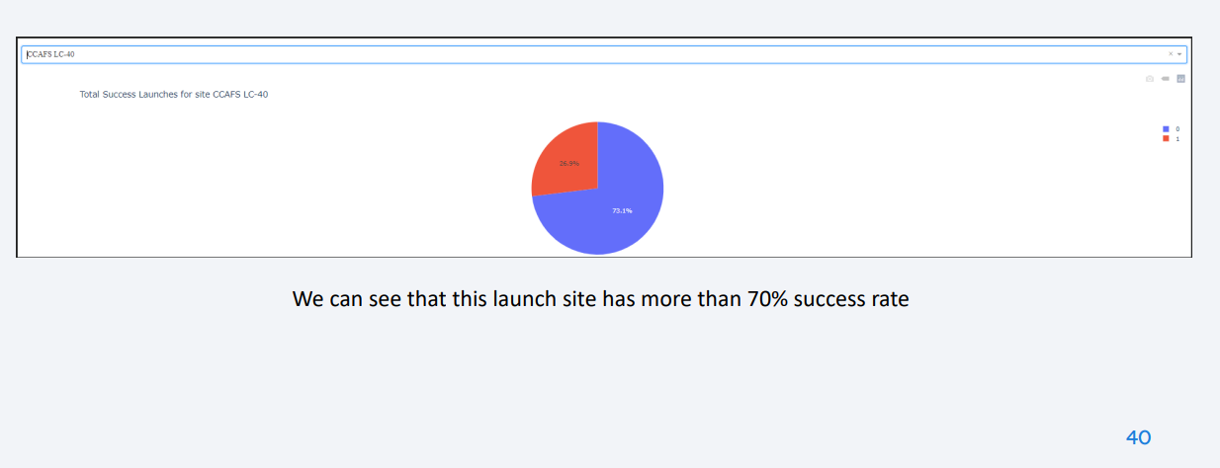
Total Success Launches for site CCAFS LC-40

Slide 41
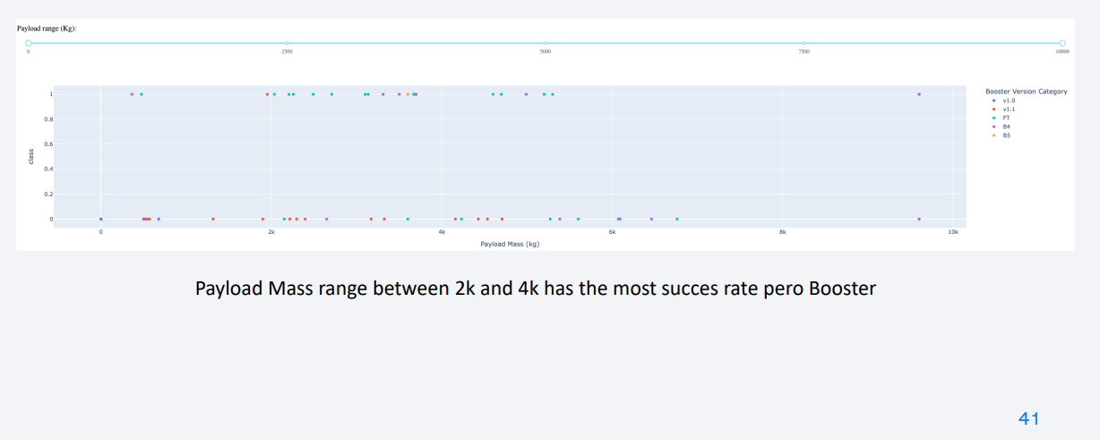
Dashboard Screenshot 3

Slide 42

Section 5

Slide 43
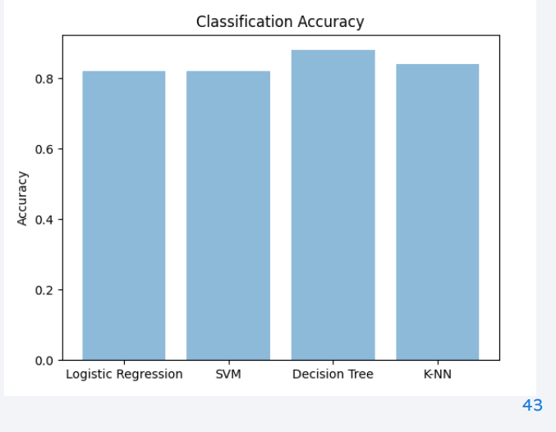
Classification Accuracy
• The right bar chart shows the final accuracy of each classification model.
• We can see that despite there is not much difference between all the classification models, Decision Tree model is the one with the highest accuracy.

Slide 44
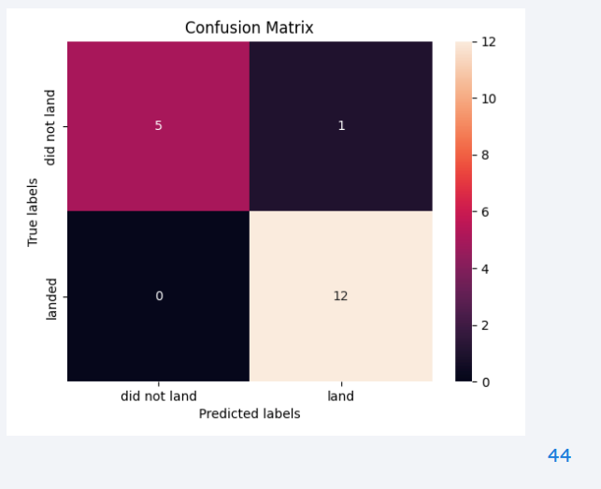
Confusion Matrix
• In the right panel we can see the confusion matrix of the decision tree model
• We can see that theres only one value that wasn’t well predicted, and that’s why this model has a R2 score of 0.94 for the predicted values.

Slide 45
Conclusions
• Despite all the different classification models have the same R2 score value (0.94) on test data, the bar chart in page 43 shows clearly that the decision tree model has a slightly better approach for the purpose of this project.
• Decision Tree model may have better accuracy due the behave of the data showed in section 2 and mainly because we have a lot of independent variables to work with (~80 features).
• Because of the number of features is relatively high, an entropy-approach like classification method is more suitable in order to model this data. That’s why Decision Tree turned out to have the best accuracy

Slide 46
Appendix
Data Collection
Data Collection – SpaceX API
Data Wrangling
EDA with Data Visualization
EDA with SQL
Predictive Analysis (Classification)
Build a Dashboard with Plotly Dash

Slide 47


